Slide 1
Polyalphabetic Ciphers
polyalphabetic substitution ciphers
improve security using multiple cipher alphabets
make cryptanalysis harder with more alphabets to guess and flatter frequency distribution
use a key to select which alphabet is used for each letter of the message
use each alphabet in turn
repeat from start after end of key is reached
Notes:
One approach to reducing the "spikyness" of natural language text is used the Playfair cipher which encrypts more than one letter at once. We now consider the other alternative, using multiple cipher alphabets in turn. This gives the attacker more work, since many alphabets need to be guessed, and because the frequency distribution is more complex, since the same plaintext letter could be replaced by several ciphertext letters, depending on which alphabet is used. The general name for this approach is a polyalphabetic substitution cipher. All these techniques have the following features in common:
A set of related monoalphabetic substitution rules is used.
2. A key determines which particular rule is chosen for a given transformation.

Slide 2
Vigenère Cipher
simplest polyalphabetic substitution cipher
effectively multiple caesar ciphers
key is multiple letters long K = k₁ k₂ ... k_{d}
i^{th} letter specifies i^{th} alphabet to use
use each alphabet in turn
repeat from start after d letters in message
decryption simply works in reverse
Notes:
The best known, and one of the simplest, such algorithms is referred to as the Vigenère cipher, where the set of related monoalphabetic substitution rules consists of the 26 Caesar ciphers, with shifts of 0 through 25. Each cipher is denoted by a key letter, which is the ciphertext letter that substitutes for the plaintext letter ‘a’, and which are each used in turn, as shown next.

Slide 3
Example of Vigenère Cipher
write the plaintext out
write the keyword repeated above it
use each plain text letter as row and key letter as column from Vigenere table.
encrypt the corresponding plaintext letter
eg using keyword deceptive
key: deceptivedeceptivedeceptive
plaintext: wearediscoveredsaveyourself
ciphertext:ZICVTWQNGRZGVTWAVZHCQYGLMGJ
Notes:
Discuss this simple example from text Stallings section 2.2.

Slide 4
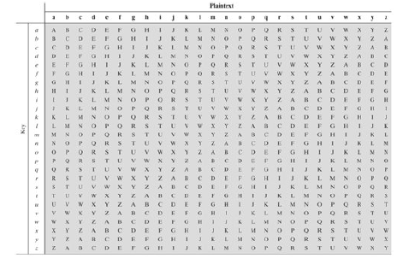
Vigenère Table

Slide 5
Security of Vigenère Ciphers
have multiple ciphertext letters for each plaintext letter
hence letter frequencies are obscured
but not totally lost
start with letter frequencies
see if look monoalphabetic or not
if not, then need to determine number of alphabets, since then can attach each
Notes:
The Vigenère & related polyalphabetic ciphers still do not completely obscure the underlying language characteristics.
The key to breaking them was to identify the number of translation alphabets, and then attack each separately.

Slide 6
Autokey Cipher
ideally want a key as long as the message
Vigenère proposed the autokey cipher
with keyword is prefixed to message as key
knowing keyword can recover the first few letters
use these in turn on the rest of the message
but still have frequency characteristics to attack
eg. given key deceptive
key: deceptivewearediscoveredsav
plaintext: wearediscoveredsaveyourself
ciphertext:ZICVTWQNGKZEIIGASXSTSLVVWLA
Notes:
Taking the polyalphabetic idea to the extreme, want as many different translation alphabets as letters in the message being sent. One way of doing this with a smallish key, is to use the Autokey cipher.
The example uses the keyword "DECEPTIVE" prefixed to as much of the message "WEAREDISCOVEREDSAV" as is needed. When deciphering, recover the first 9 letters using the keyword "DECEPTIVE". Then instead of repeating the keyword, start using the recovered letters from the message "WEAREDISC". As recover more letters, have more of key to recover later letters.
Problem is that the same language characteristics are used by the key as the message. ie. a key of 'E' will be used more often than a 'T' etc hence an 'E' encrypted with a key of 'E' occurs with probability (0.1275)2 = 0.01663, about twice as often as a 'T' encrypted with a key of 'T' have to use a larger frequency table, but it exists given sufficient ciphertext this can be broken.

Slide 7
Vernam Cipher
Consider plain text as stream of bits.
Key will also be stream of bits.
Perform XOR between plain text and key bits to get bits of cipher text.
To decrypt perform XOR between bits of cipher text and key bits again.

Slide 8

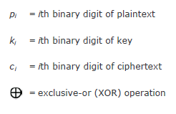

Vernam Cipher

Slide 9
Transposition Ciphers
now consider classical transposition or permutation ciphers
these hide the message by rearranging the letter order
without altering the actual letters used
can recognise these since have the same frequency distribution as the original text
Notes:
All the techniques examined so far involve the substitution of a ciphertext symbol for a plaintext symbol. A very different kind of mapping is achieved by performing some sort of permutation on the plaintext letters. This technique is referred to as a transposition cipher, and form the second basic building block of ciphers. The core idea is to rearrange the order of basic units (letters/bytes/bits) without altering their actual values.

Slide 10
Rail Fence cipher
write message letters out diagonally over a number of rows
then read off cipher row by row
eg. write message out as:
m e m a t r h t g p r y
e t e f e t e o a a t
giving ciphertext
MEMATRHTGPRYETEFETEOAAT
Notes:
The simplest such cipher is the rail fence technique, in which the plaintext is written down as a sequence of diagonals and then read off as a sequence of rows.
The example message is: "meet me after the toga party" with a rail fence of depth 2.
This sort of thing would be trivial to cryptanalyze.

Slide 11
Row Transposition Ciphers
a more complex transposition
write letters of message out in rows over a specified number of columns
then reorder the columns according to some key before reading off the rows
Key: 3 4 2 1 5 6 7
Plaintext: a t t a c k p
o s t p o n e
d u n t i l t
w o a m x y z
Ciphertext: TTNAAPTMTSUOAODWCOIXKNLYPETZ
Notes:
A more complex transposition cipher is to write the message in a rectangle, row by row, and read the message off shuffling the order of the columns in each row.
A pure transposition cipher is easily recognized because it has the same letter frequencies as the original plaintext. For the type of columnar transposition just shown, cryptanalysis is fairly straightforward and involves laying out the ciphertext in a matrix and playing around with column positions. Digram and trigram frequency tables can be useful.

Slide 12
Product Ciphers
ciphers using substitutions or transpositions are not secure because of language characteristics
hence consider using several ciphers in succession to make harder, but:
two substitutions make a more complex substitution
two transpositions make more complex transposition
but a substitution followed by a transposition makes a new much harder cipher
this is bridge from classical to modern ciphers
Notes:
Have seen that ciphers based on just substitutions or transpositions are not secure, and can be attacked because they do not sufficient obscure the underlying language structure
So consider using several ciphers in succession to make harder.
A substitution followed by a transposition is known as a Product Cipher, and makes a new much more secure cipher, and forms the bridge to modern ciphers.

Slide 13
Rotor Machines
before modern ciphers, rotor machines were most common complex ciphers in use
widely used in WW2
German Enigma, Allied Hagelin, Japanese Purple
implemented a very complex, varying substitution cipher
used a series of cylinders, each giving one substitution, which rotated and changed after each letter was encrypted
Notes:
The next major advance in ciphers required use of mechanical cipher machines which enabled to use of complex varying substitutions.
A rotor machine consists of a set of independently rotating cylinders through which electrical pulses can flow. Each cylinder has 26 input pins and 26 output pins, with internal wiring that connects each input pin to a unique output pin. If we associate each input and output pin with a letter of the alphabet, then a single cylinder defines a monoalphabetic substitution. After each input key is depressed, the cylinder rotates one position, so that the internal connections are shifted accordingly. The power of the rotor machine is in the use of multiple cylinders, in which the output pins of one cylinder are connected to the input pins of the next, and with the cylinders rotating like an “odometer”, leading to a very large number of substitution alphabets being used, eg with 3 cylinders have 26³=17576 alphabets used.
They were extensively used in world war 2, and the history of their use and analysis is one of the great stories from WW2.

Slide 14
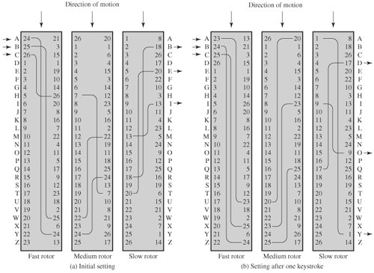
Rotor Machines

Slide 15
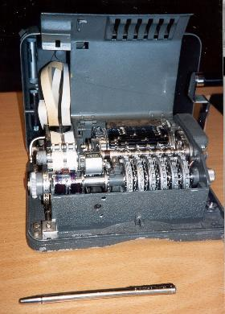
Hagelin Rotor Machine
Notes:
This photo of an Allied Hagelin machine was taken by Lawrie Brown at Eurocrypt'93 in Norway. Note pen for scale, and the rotating cipher wheels near the front.

Slide 16
Steganography
an alternative to encryption
hides existence of message
using only a subset of letters/words in a longer message marked in some way
using invisible ink
hiding in LSB in graphic image or sound file
has drawbacks
high overhead to hide relatively few info bits
Notes:
Steganography is an alternative to encryption which hides the very existence of a message by some means. There are a large range of techniques for doing this.
Steganography has a number of drawbacks when compared to encryption. It requires a lot of overhead to hide a relatively few bits of information.
Also, once the system is discovered, it becomes virtually worthless, although a message can be first encrypted and then hidden using steganography.

Slide 17
Examples of Steganography
Selecting first letter from each word of a sentence from a paragraph.
Selecting letters from words of sentences of a paragraph in increasing order.

Slide 18
Block Ciphers and Data Encryption Standards
Modern symmetric ciphers.
Simplified DES algorithm:
Provides user a facility to perform encryption and decryption by hand.
To understand the DES (Data Encryption Standard) algorithm.
S-DES has same properties as of DES with much smaller parameter.
So it is helpful to understand the functionality of DES.
Performs operations on bits of data.
Plain text and key should be in form of bits.

Slide 19
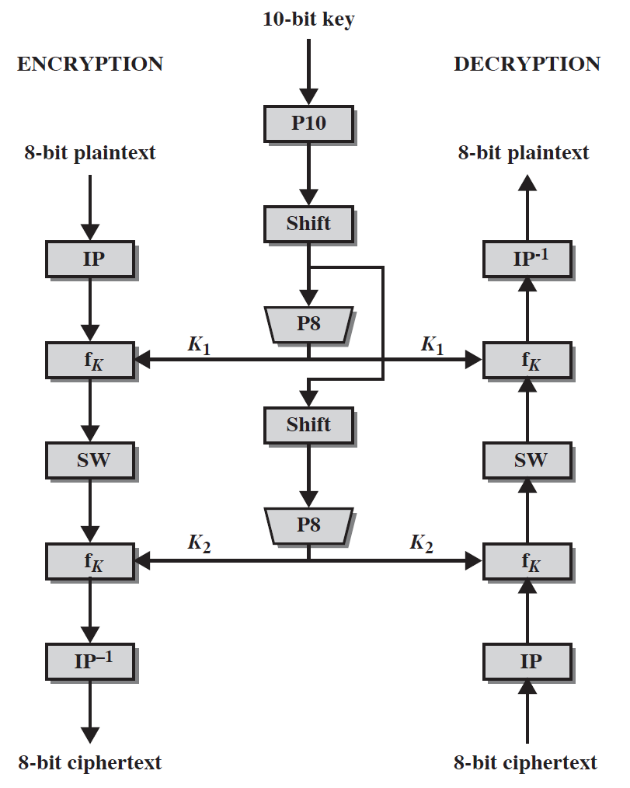
S-DES algorithm structure

Slide 20
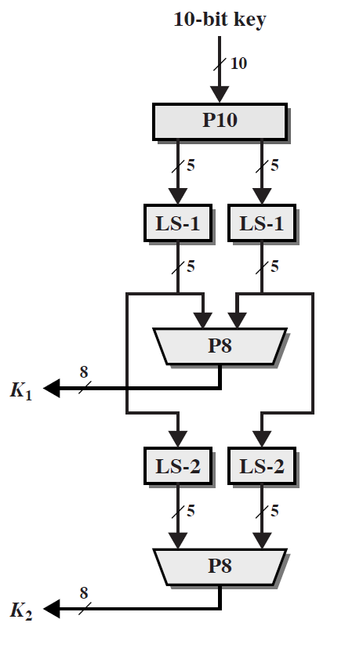
Key generation from S-DES

Slide 21
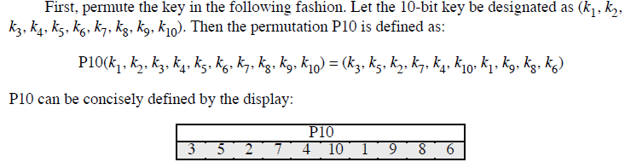
Function of P10

Slide 22
Function of LS-1
perform a circular left shift (LS-1), or rotation, separately on the first
five bits and the second five bits.
In our example, the result is (00001 11000).

Slide 23
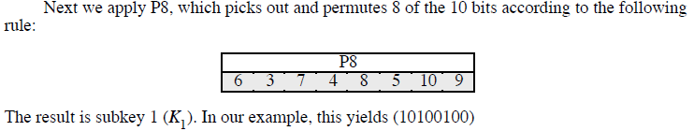
Function of P8

Slide 24
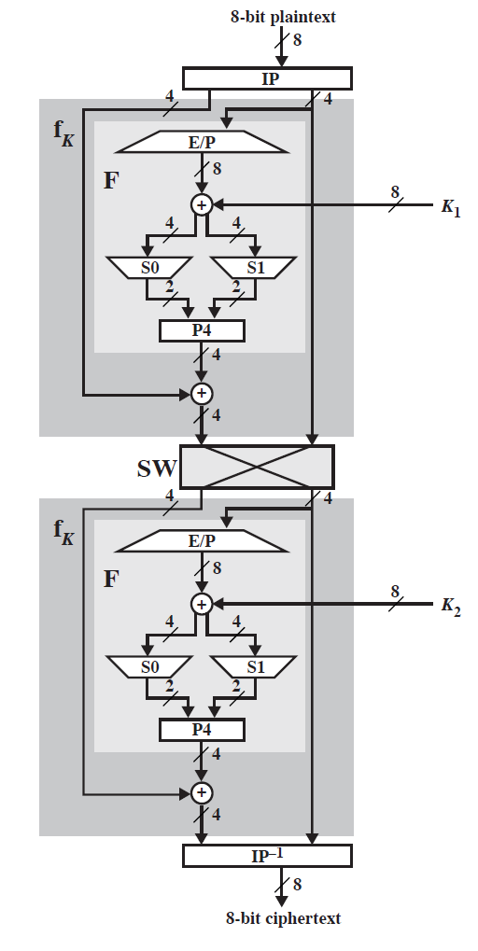
Encryption details of S-DES

Slide 25
Reading Assignment # 1
Study the document related to simplified DES algorithm available in lectures folder of course.
How many key combinations will be required to perform Brute Force attack on S-DES algorithm?
How we may perform crypt analysis of S-DES algorithm?

Slide 26
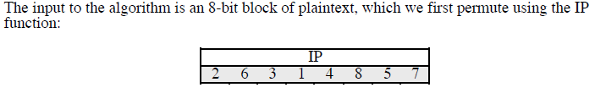
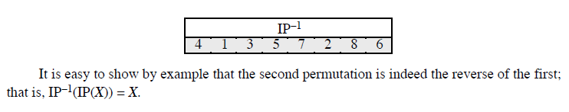
Initial and Inverse Initial Permutations

Slide 27
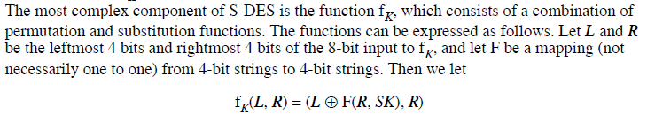
Function f_{k}

Slide 28

Function of f_{k} (Expansion/Permutation)
We now describe the mapping F. The input is a 4-bit number (n1n2n3n4). The first operation is an expansion/permutation operation:

Slide 29
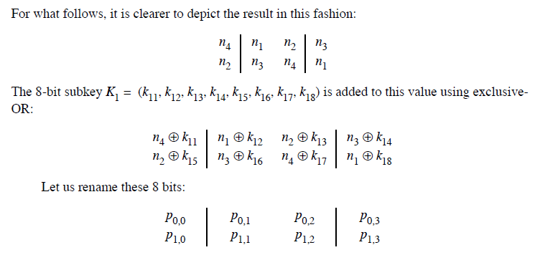
Function f_{k} (XOR with key )

Slide 30

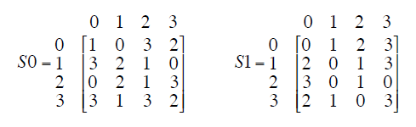
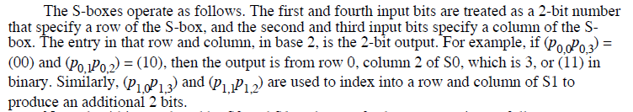
Function f_{k} (S boxes)

Slide 31
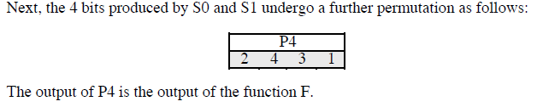
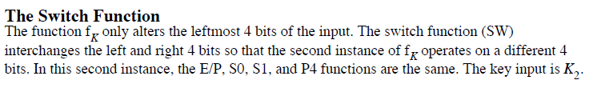
Function f_{k} (Permutation P4 and Switch)

